Slide 1
Tableau Dashboard

Slide 2
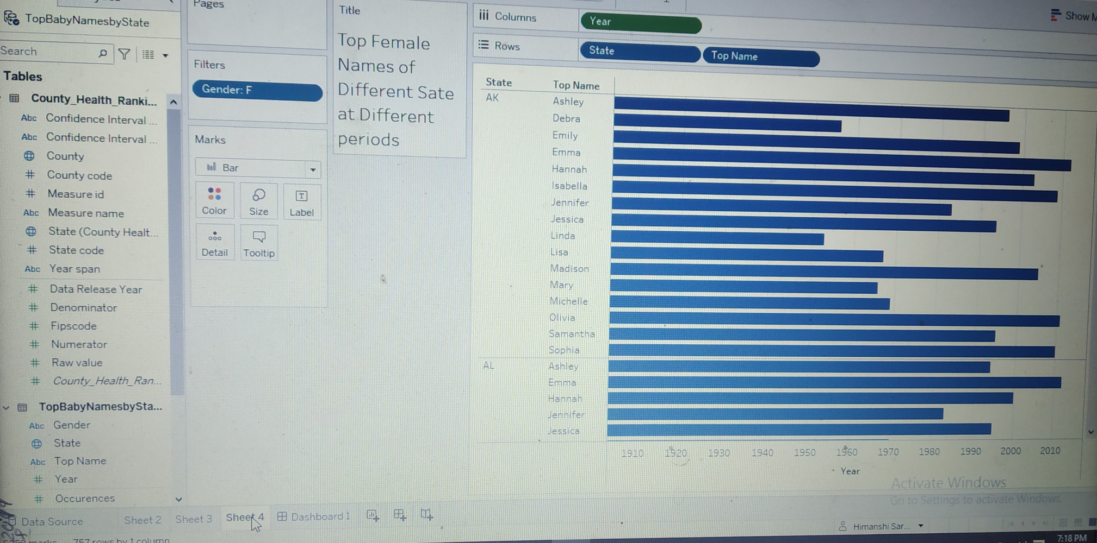
Analyses the data of Top Female Names at UK
By analyzing the data we can say that Emma name is more famous state UK in 2010

Slide 3
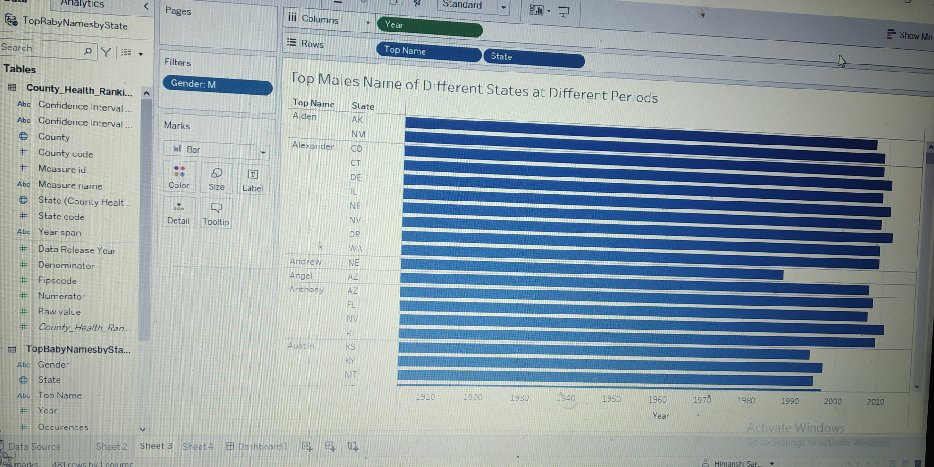
Analyses the data of Top Male Names at UK
By analyzing the data we can say that Alexanda name is more famous in the state NV in the period 2009

Slide 4
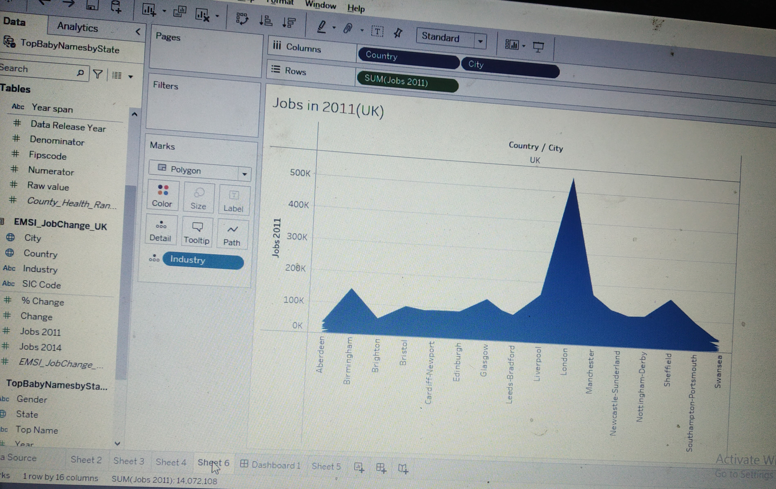
Jobs opportunity at UK in the period 2011
By using the polygon diagram, we can say that at the period 2011, London has more job opportunity as compare to other countries

Slide 5
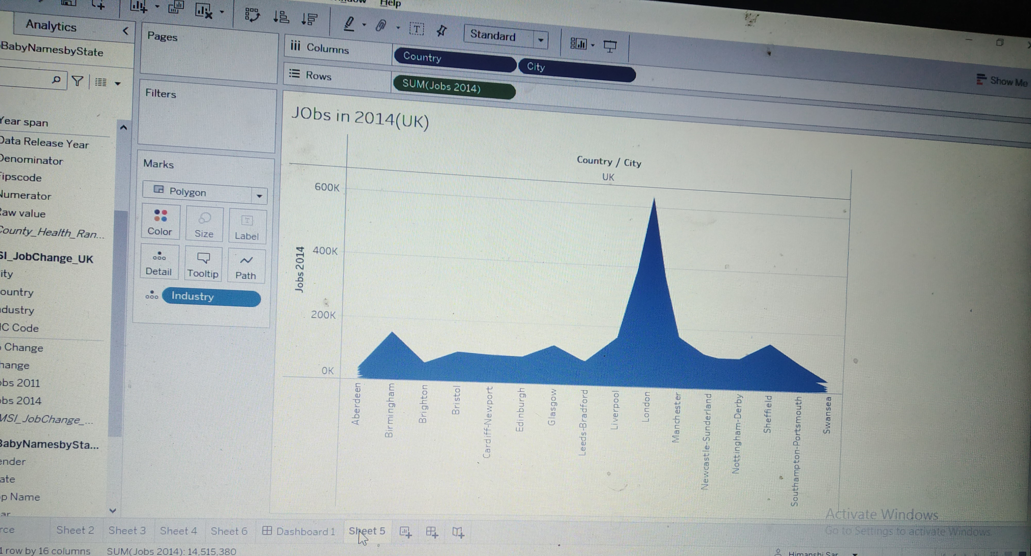
Jobs opportunity at UK in the period 2014
By using the polygon diagram, we can say that at the period 2014, London has more job opportunity as compare to other countries which is 600k

Slide 6
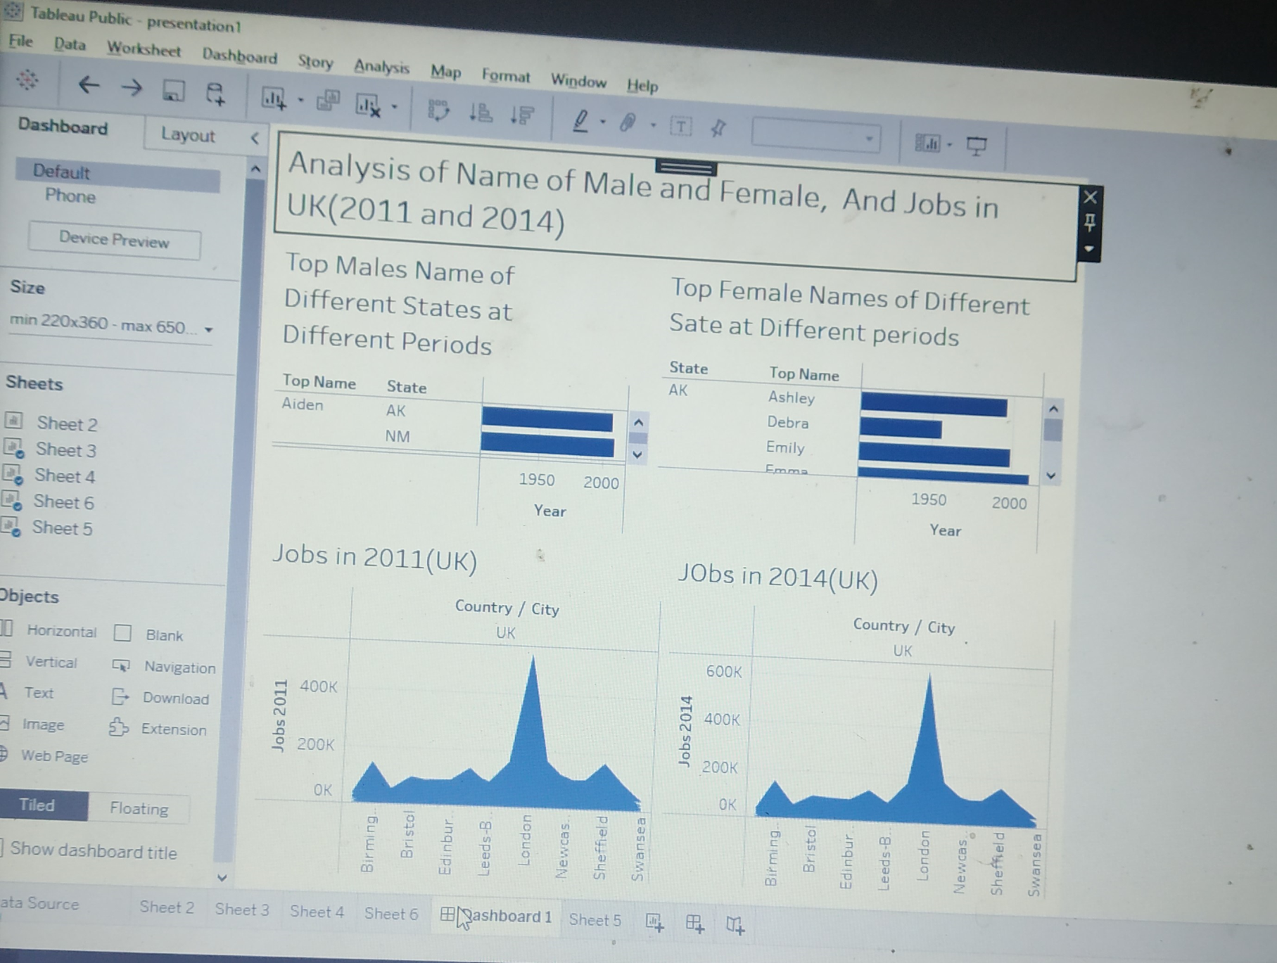
Dashboard

Slide 7

Thank You

